Slide 1
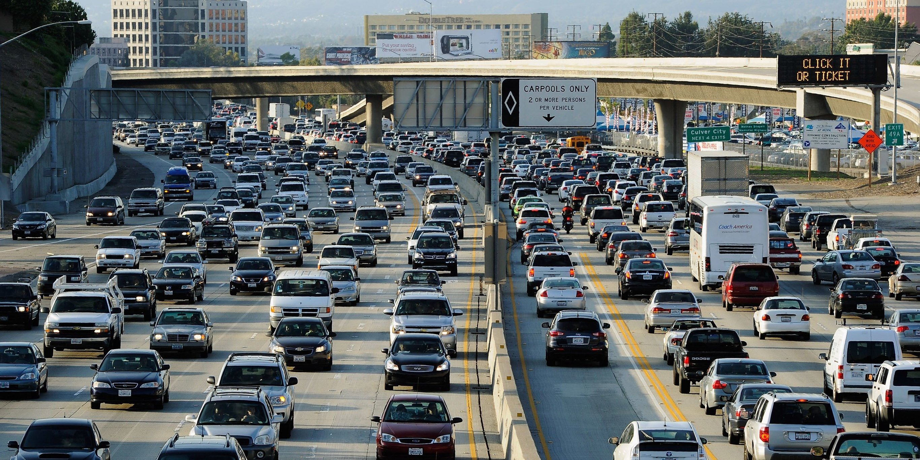
South Carolina Department of Alcohol & Other Drug Abuse Services (SC DAODAS)
Quarterly Prevention Meeting
Terecia W. Wilson, Professor of Practice, IGRSS Assistant Director
November 7, 2019

Slide 2
Need for a Degree-Granting Program
Motor vehicle crashes in US and in developing nations remains leading cause of unintentional injuries and deaths
Motor vehicle crashes result in tremendous economic cost nationally & internationally, representing 1% - 2% of a nation’s gross national product
Motor vehicle crashes are creating a public health crisis worldwide
There is a need to build capacity and create a road safety workforce that is competent and capable of implementing new tools and technologies to improve safety through multi-disciplinary, evidence-based approaches.

Slide 3
Need for a Degree-Granting Program
“In the past, most decisions were based on intuition and judgment. . . A broad class of professionals, those who influence the future of road safety, needs to be trained in fact-based road safety knowledge. . . “
“In addition, a vibrant, competent community of road safety researchers has to be created. They need to be trained in the same road safety knowledge as well as in research methods.”
- Ezra Hauer, Professor Emeritus, University of Toronto, Canada

Slide 4
Need for a Degree-Granting Program
Transportation Research Board (TRB) of the National Academies of Science established a Task Force on Highway Safety Workforce Development
TRB later established ANB23 Standing Committee on Highway Safety Workforce Development. Goals of the Committee:
Encourage colleges/universities to establish degree program in road safety
Develop a textbook that could be used by colleges/universities
Develop a professional certification program for road safety professionals

Slide 5
Need for a Degree-Granting Program
Survey by Frank Gross and Paul Jovanis of US universities and assessment of existing college level courses concluded:
No current programs available that cover highway safety core competency materials (TRB Research Results Digest 302)
No degree-granting programs in the US in road safety management
Limited highway safety course offerings in engineering and public health university programs within the United States

Slide 6
Need for a Degree-Granting Program
National Strategy on Highway Safety developed by American Association of State Highway & Transportation Officials (AASHTO) and other stakeholders adopted nationally and now being implemented
Strategy is part of the “Towards Zero Deaths” (TZD) movement
Data-driven effort, focuses on developing strong champions and leaders who can directly impact highway safety through multi-disciplinary approaches
The accomplishment of TZD is predicated on and cannot be effectively achieved without a well-educated road safety workforce capable of deploying multi-disciplinary, science- based strategies supported by on-going research.

Slide 7
Need for a Degree-Granting Program
The road safety workforce in public sector is dispersed among thousands of federal, state and local agencies
Encompasses a diversity of expertise in fields such as education, enforcement, emergency response, engineering, public health, public policy, alcohol and drug abuse prevention, psychology, research, etc.
Progress in road safety requires a vigorous application of scientific and systems-level approaches to safety management by well-educated and well-trained safety experts
Experts must have wide range of knowledge and skills from many disciplines

Slide 8
What is a Road Safety Professional?
Workers who spend all or most of their workday on matters pertaining directly to road safety, such as planning, developing and implementing safety initiatives, and taking specific actions related to safety
Examples:
Directors and staff of Governor’s Highway Safety Offices
Safety program developers and evaluators
Road safety engineers
Alcohol & drug abuse professionals that coordinate underage drinking and driving programs and/or coalitions that work to prevent DUI – Is this YOU?

Slide 9
Master of Transportation Safety Administration (MTSA)
First Master’s degree program of its kind in the United States
On-line program offered asynchronously / synchronously
Incorporates “Core Competencies for Highway Safety Professionals”
Includes 14 professors from 7 of the University’s 8 colleges

Slide 10
Master of Transportation Safety Administration (MTSA)
Interdisciplinary, multidisciplinary, team-based approach
Thirty hour (two year program); non-thesis
Internships and special project opportunities
No GRE required for those with 2+ years road safety experience
Fully approved and accredited graduate degree program

Slide 11
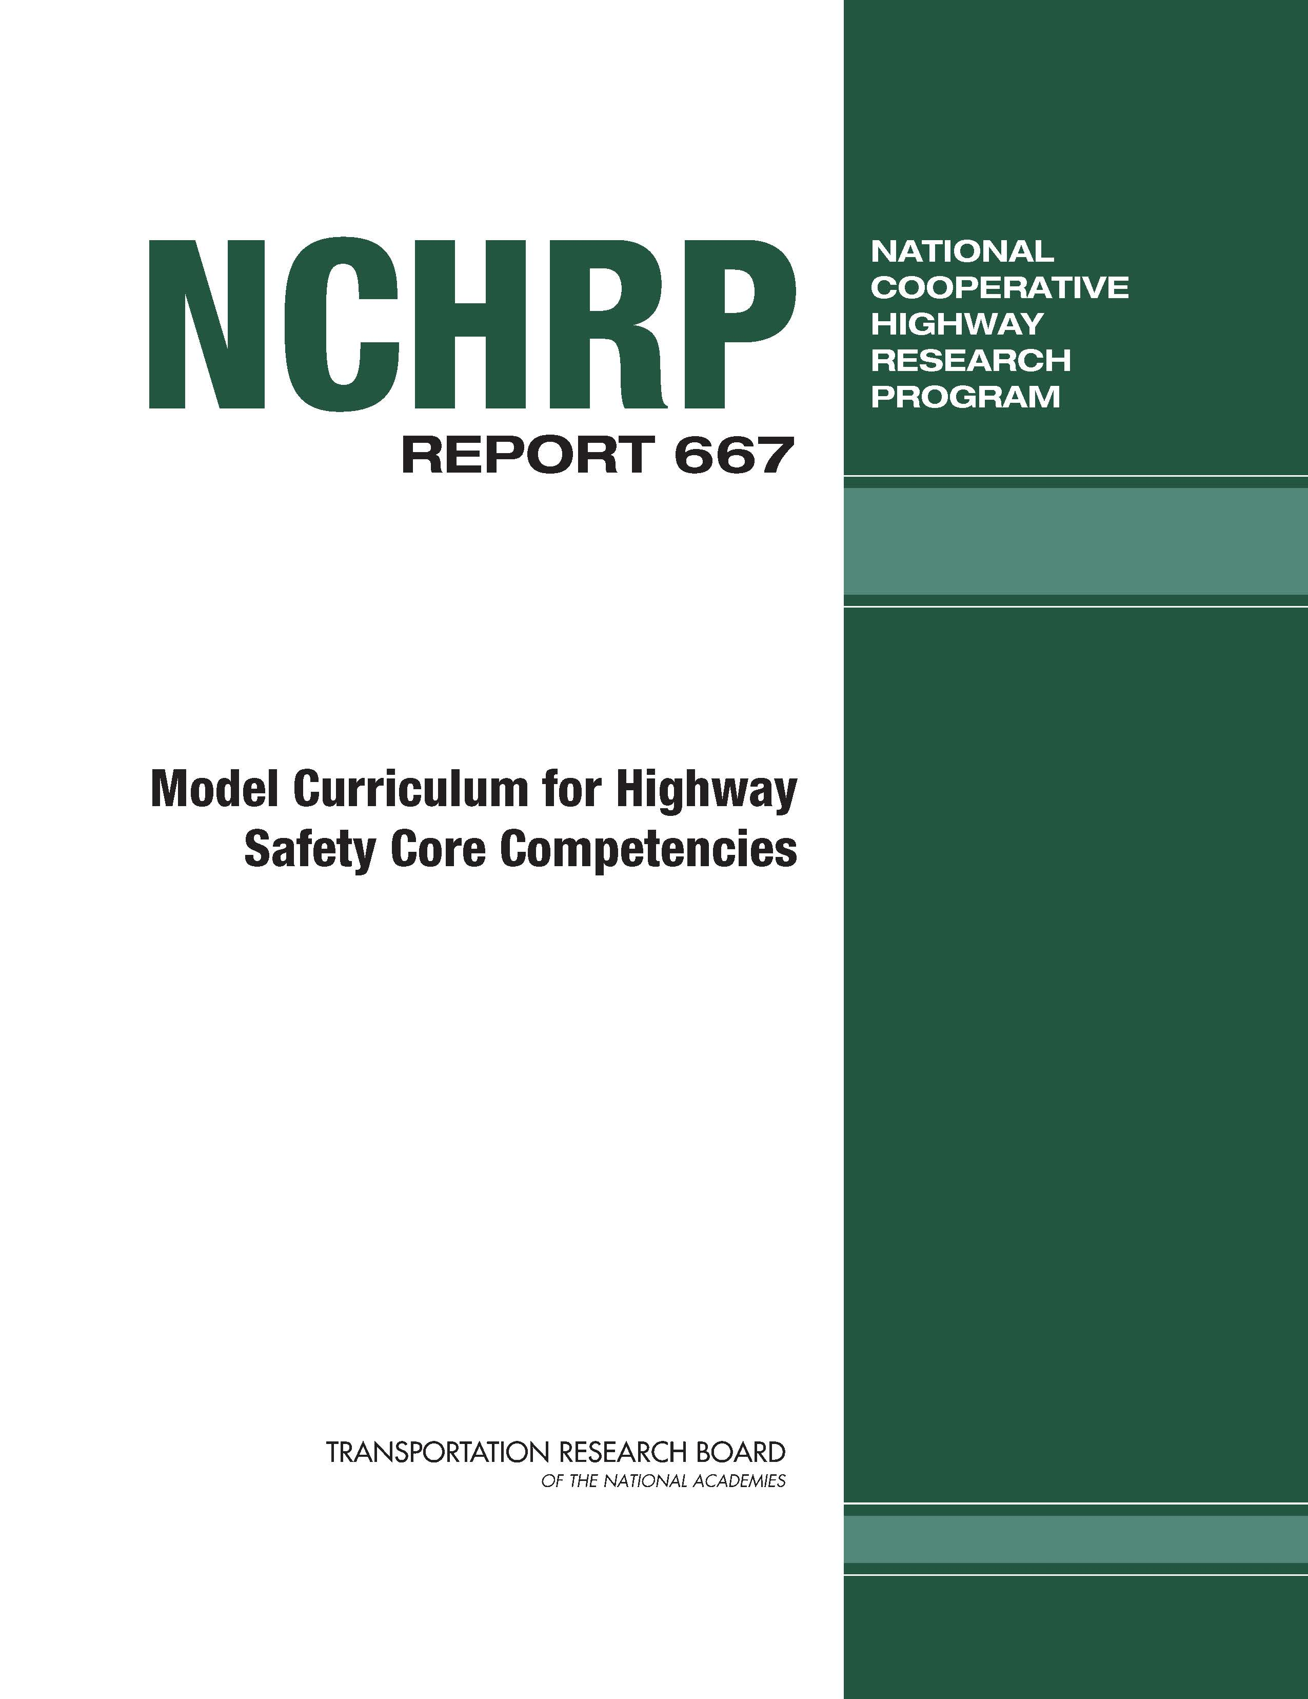
Partial List of MTSA Courses
Four core courses:
Introduction to Road Safety: Road Safety Fundamentals
Road Safety Management
Understanding Traffic Safety Culture
Transportation Safety Engineering
18 hours (6 courses) thematic interests

Slide 12
Partial List of MTSA Courses: Electives
Human Factors in Transportation Safety
Public Policy Process / Strategic Planning / State Government Administration
Trends in Public Relations and Communications
Traffic Safety (Includes vehicle design, autonomous vehicles, etc.)
Judgment and Decision-Making
Transportation Planning

Slide 13
List of MTSA Courses: Electives
Conducting Needs Assessments
Applied Research / Analytic Methods
Introduction to Statistics
Public Management
Program Evaluation
Traffic Enforcement
Digital Creativity

Slide 14
MTSA Overview
Future of transportation safety requires developing creative leadership, working in interdisciplinary teams and applying scientific and systems approaches. MTSA is structured on:
Team-based learning approaches
Class lectures and real-world case study discussions
Reviews of best practices & successful strategies from across the US and other nations around the world
Review national and international issues in road safety
Guest lectures from key national and international leaders in road safety

Slide 15
Sample MTSA Resources
Road Safety Fundamentals (FHWA)
NHTSA Countermeasures That Work: A Highway Safety Countermeasures Guide for State Highway Safety Offices (9th Edition)
The AASHTO Highway Safety Manual
ITE Traffic Engineering Handbook, 7th Edition
Human Factors in Traffic Safety, 3rd Edition (Alison Smiley)
NCHRP 500 Series Reports
PIARC Road Safety Manual

Slide 16
MTSA Technical Advisory Committee (TAC)
Prominent national leaders with tremendous road safety expertise
Represent behavioral safety, infrastructure safety, injury prevention, driver and vehicle services administration, commercial motor vehicle safety, road safety research, and private industry
Deliver guest lectures
Serve as mentors for MTSA students – all MTSA students will have a mentor
Review and provide feedback on overall MTSA program and course offerings
Bring latest industry perspectives to the program

Slide 17
MTSA Technical Advisory Committee (TAC)
Dr. Elizabeth Baker NHTSA Region III Administrator (Behavioral Safety Programs)
Dr. Ann Dellinger Chief, Injury Prevention Center, Centers for Disease Control (Public Health)
Anne S. Ferro President & CEO, American Association of Motor Vehicle Administrator (AAMVA) (Driver & Vehicle Services), former Administrator Federal Motor Carrier Safety Administration (FMCSA
Lorrie Laing Principal, Cambridge Systematics (Private Sector; Behavioral Safety)
Dr. Richard F. Pain Senior Program Officer Emeritus, Technical Activities Division, Transportation Research Board (TRB), The National Academies of Sciences (Research)

Slide 18
MTSA Technical Advisory Committee (TAC)
Mr. Richard Retting Vice-President, Sam Schwartz Engineering; formerly Senior Research Scientist, Insurance Institute for Highway Safety (Research)
Michael Trentacoste Associate Administrator for Research, Development and Technology; Director of Turner Fairbanks Highway Research Center, FHWA (Infrastructure)
Dr. Denver Tolliver Director, Upper Great Plains Transportation Institute, North Dakota State University; Director, Mountain-Plains Consortium; and former Provost, Clemson University
Sheryl Wilkerson Vice-President, Governmental Affairs, Michelin North America (Business and Technology)

Slide 19
Who Are Prospective MTSA Students?
Road safety professionals seeking an advanced degree, including personnel from:
government agencies
non-profits & advocacy organizations
the private sector
professional associations
research institutes
Bachelor’s degree graduates planning to pursue a career in road safety

Slide 20
Who Are Prospective MTSA Students?
Directors and staff members of State Highway Safety Offices
Road safety engineers
Law enforcement supervisors & senior management personnel directing traffic safety enforcement programs
Injury prevention and public health specialists; emergency response personnel
Safety data analysts and researchers
Safety program developers and evaluators; safety program educators; driver education instructors
Public policy staff/finance staff supporting road safety/marketing & communications specialists
Driver and vehicle services administrators
Transportation safety planners; alcohol and drug prevention specialists and directors of prevention

Slide 21
How Can You Apply?
All applications are made online at https://www.applyweb.com/clemsong/index.ftl
Applicants must submit the following:
Transcripts showing a Bachelor’s degree from nationally-accredited college or university
A Statement of Purpose along with a current CV
Three professional references
GRE test scores are waived for applicants demonstrating two (2) or more years of employment in a transportation safety setting
Students from countries where English is NOT the native language must provide IELTS scores

Slide 22
How Much is the Tuition? Is There Financial Assistance?
Tuition is the same for all applicants, regardless of their location in the world
Current tuition & fees are available at https://www.clemson.edu/finance/student-financials/tuition-fees/.
Check with your employer about their tuition reimbursement program
All applicants will be considered for fellowships available upon applying
Dean’s MTSA Fellowship: Total award of $20,000 for use over two year period
Chairman’s MTSA Fellowship: Total award of $10,000 for use over two year period
Director’s MTSA Fellowship: Total award of $2,000 for use over two year period

Slide 23
What Should I Know About Clemson?
Currently ranked #23 among national public universities
An original land grant university founded in 1889 with the mission of teaching, research and service
Science and technology-oriented with student-centered research
About 20,000 undergraduate students and over 5,000 graduate students
Campus sets midway between Atlanta, Georgia and Charlotte, North Carolina on 1,400 acres in the foothills of the Blue Ridge Mountains, along the shores of Lake Hartwell

Slide 24
What Should I Know About Clemson?
An R1 ranked public research university; the Palmetto Cluster ranks 8th on the list of University-owned supercomputers in the United States
University offers a 17-to-1 faculty/student ratio; nearly half of Clemson’s classes have fewer than 20 students
Clemson is both competitive and inclusive – a place where big ideas can and do thrive
Rated #1 as having the happiest students of any college or university in the US
Home of the 2016 and 2018 National Football Championship Team – the Clemson Tigers!!!

Slide 25
What Should I Know About Clemson?
The Graduate School at Clemson offers 120 different graduate programs
One of every five (5) Clemson students is a graduate student
About 14% of the University’s resident graduate students belong to a racial or ethnic community historically underrepresented in higher education
Graduate school offers traditional on-campus programs, blended learning, and online programs
Clemson’s Graduate School focuses on theme of “transformation” for its 5,300 students as they earn master’s and doctoral degrees in the more than 120 credentialed programs

Slide 26
Need for Masters Degree in Road Safety Management
Build professional capacity
Create a highly skilled road safety workforce
Produce competent and capable professionals
Implement new tools and technologies
Learn to work in Multidisciplinary teams; break down the silos!
Utilize evidence-based approaches
Building the Road Safety Workforce in Support of Towards Zero Deaths!

Slide 27
For Additional Information About MTSA:
Apply TODAY at https://www.applyweb.com/clemsong/index.ftl
Visit us at clemson.edu/mtsa
For additional information, contact:
Dr. Kim Alexander, Executive Director of IGRSS & Clinical Associate Professor at kalxndr@clemson.edu
Building the Road Safety Workforce in Support of Towards Zero Deaths!

